Slide 1
FINAL ASSESSMENT
By-Abhishek Meena
Employee id- 4346

Slide 2
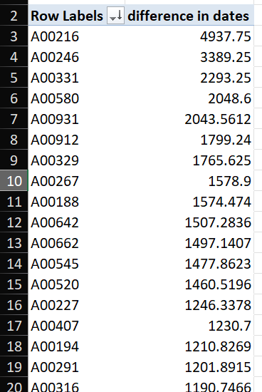
Case Study - 1
average lead time between request and completion date in descending order with Order id’s

Slide 3
Case Study - 1
Graph explaining average lead time between request and completion date

Slide 4
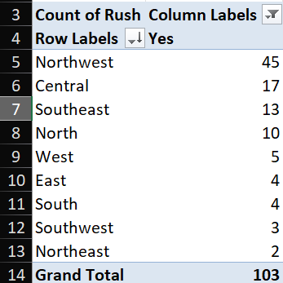
Case Study - 2
We can notice the northwest district has the highest number of rush jobs -45.

Slide 5
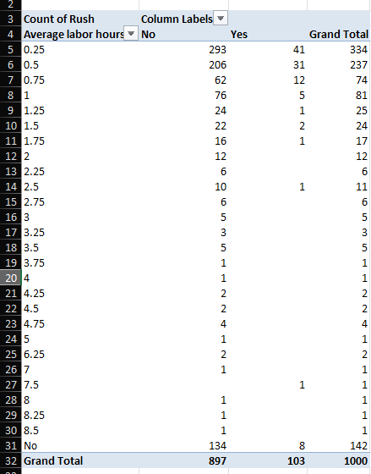
Case Study - 3
From the data, we can notice how average labour hours differ between rush and non-rush jobs

Slide 6
Case Study - 3 (continued)
Similarly, understood with the help of a graph.

Slide 7
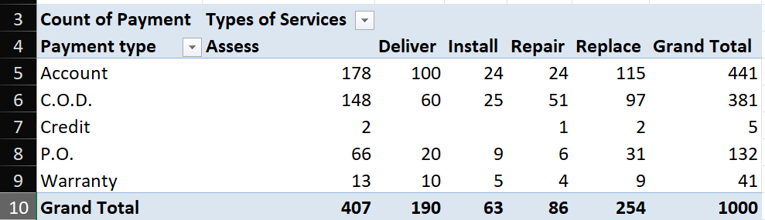
Case Study -4
Types of payments (Accounts, COD, Credits, PO, Warranty) with the respective services are shown in the table.

Slide 8
Case Study -4 (continued)

Slide 9
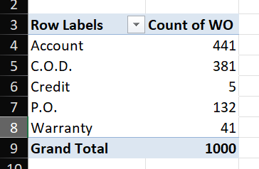
Case Study -5
Different payment types with Work Orders mentioned.

Slide 10
Case Study -5(continued)

Slide 11
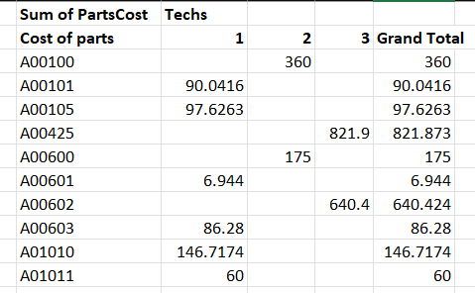
Case Study -6
Yes, the relation is visible clearly as more the number of techs the higher is the cost of parts

Slide 12
Case Study -6 (continued)
Blue data represents Tech-1
Orange data represents Tech-2
Green data represents Tech-3

Slide 13
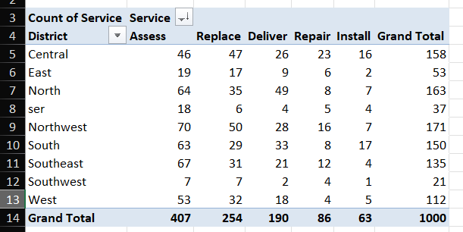
Case Study - 7
Assess service is used the most in most of the districts as seen.

Slide 14
Case Study – 7(continued)

Slide 15
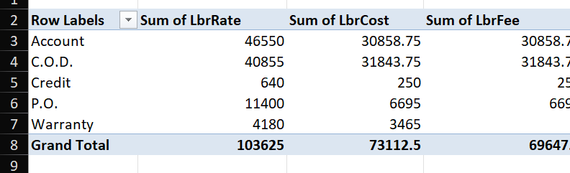
Case Study – 8
Distribution of Labour rate, Labour Cost and Labour fee with respect to various payment types.

Slide 16
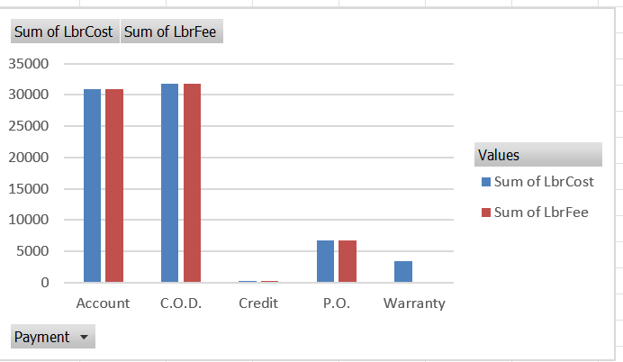
Case Study – 8

Slide 17
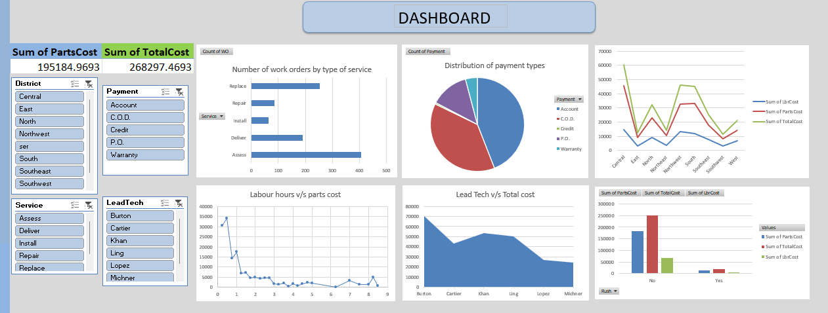
DASHBOARD

Slide 18
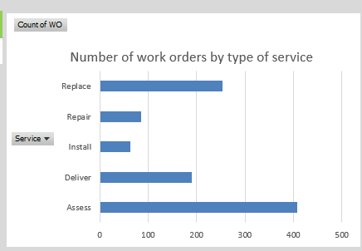
Dashboard explained…
Displays the amount of work orders by a type of service

Slide 19
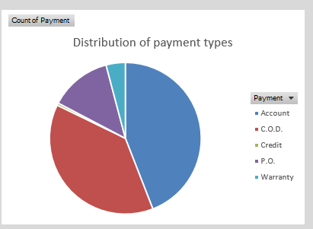
Dashboard explained…
Explains various payment types

Slide 20
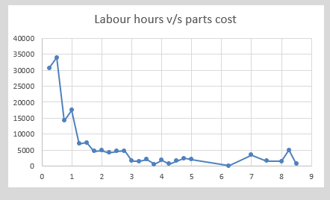
Dashboard explained…
Gives a glimpse of labour hours and how it affects parts cost

Slide 21
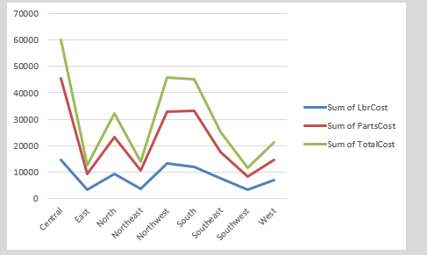
Dashboard explained…
Explains district wise Sum of Labour cost, Parts cost and total cost

Slide 22
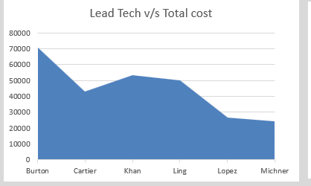
Dashboard explained…
Which lead tech is more profitable for the company is mentioned

Slide 23
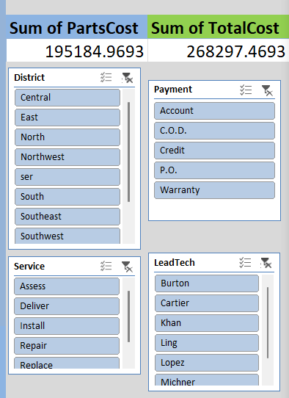
Dashboard explained…
Interactive Slicers to interact with the dashboard.

